Slide 1
IMPETUS Programming Language
Purushothama Shathappa, Praneeth Kumar Reddy Kotha, Rahul Ghanghas

Slide 2
Language Features
Features | Types
Datatype | num, boolean, string
Boolean operator | and, or, not
Relational operator | <, >, <=, >=, ==, !=
Arithmetic operator | +, -, /, *, (, )
Assignment operator | =
Conditional operator | if else, ternary
Looping Construct | traditional for and while loop, for in range(x,y)
Printing | print()

Slide 3
Language Features
Data structure – Stack, Queue and List
String Concatenation operation
Variable Scope Checking
Type Checking during Parsing
Functions

Slide 4
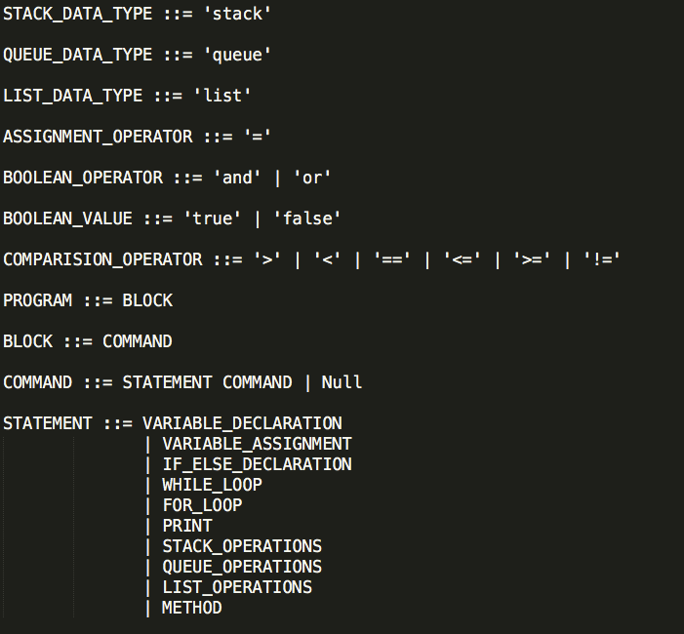
Grammar

Slide 5
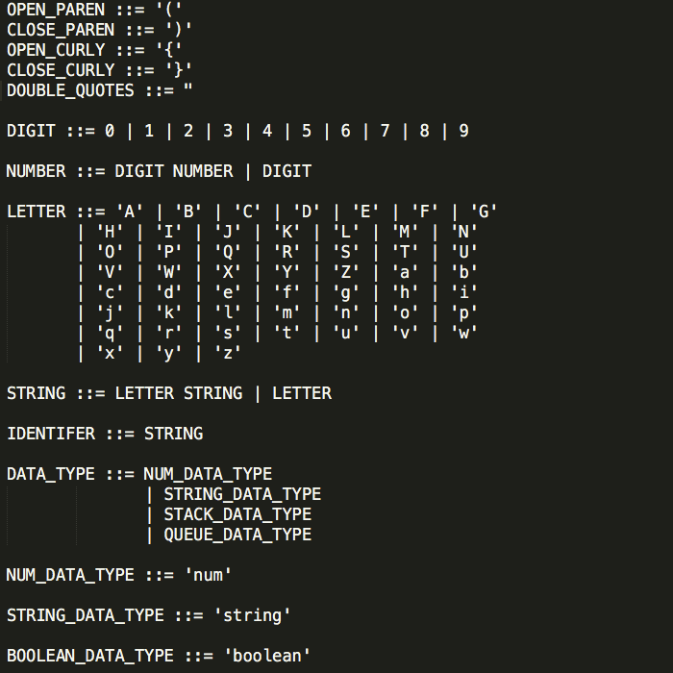
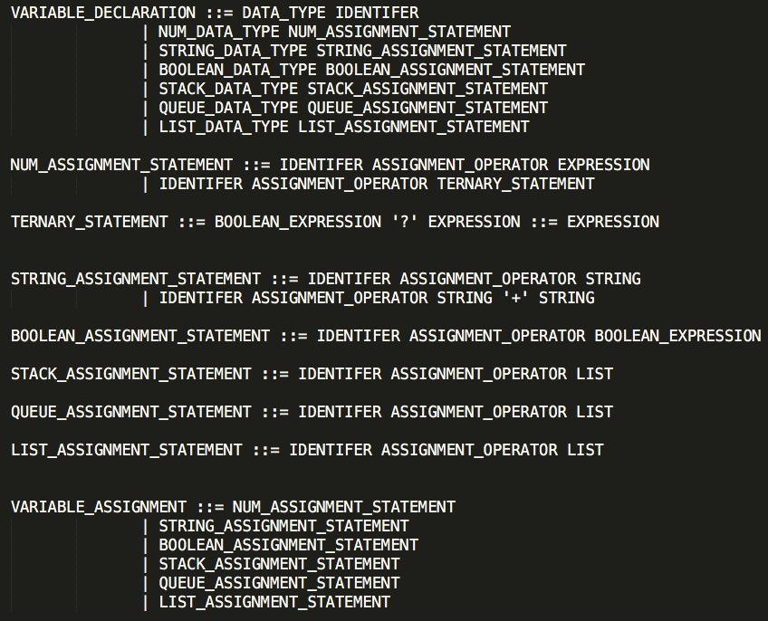
Grammar

Slide 6
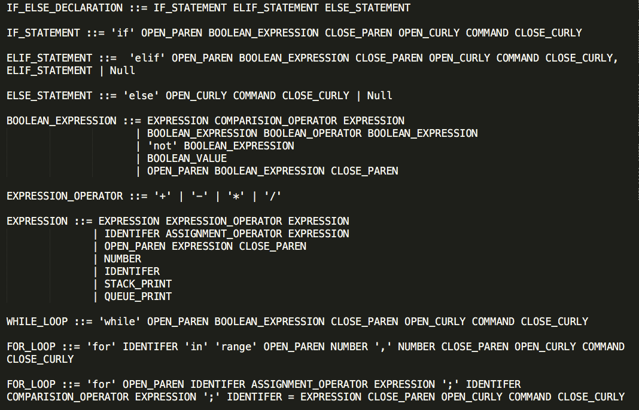
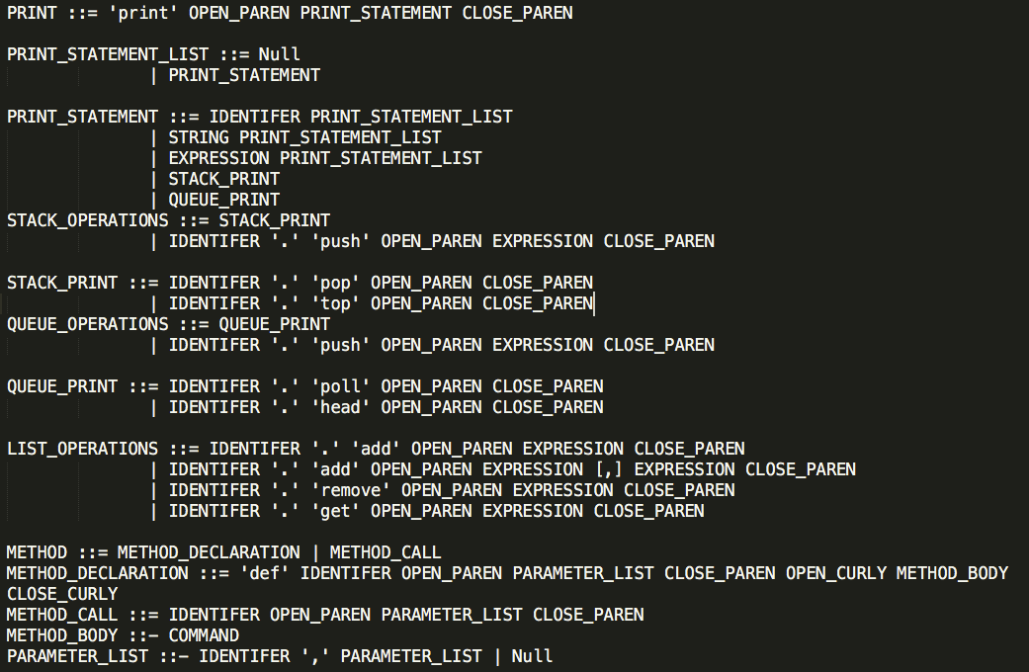
Grammar

Slide 7
Compiler Design Process
Input file
Lexer
Tokens Generated
Parser
Output
Semantics
Parse tree / AST Generated

Slide 8
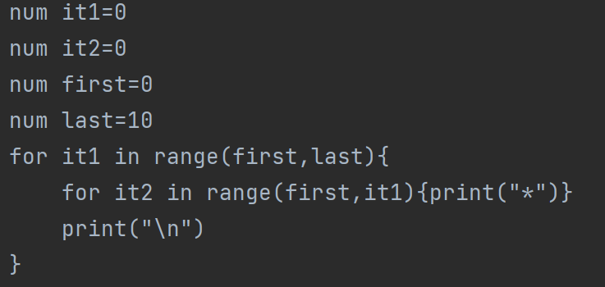
Lexer
Lexer reads the characters from source program and groups them into lexemes (sequence of characters that “go together”). Each lexeme corresponds to a token.
Lexer Input:
Lexer Output:

Slide 9
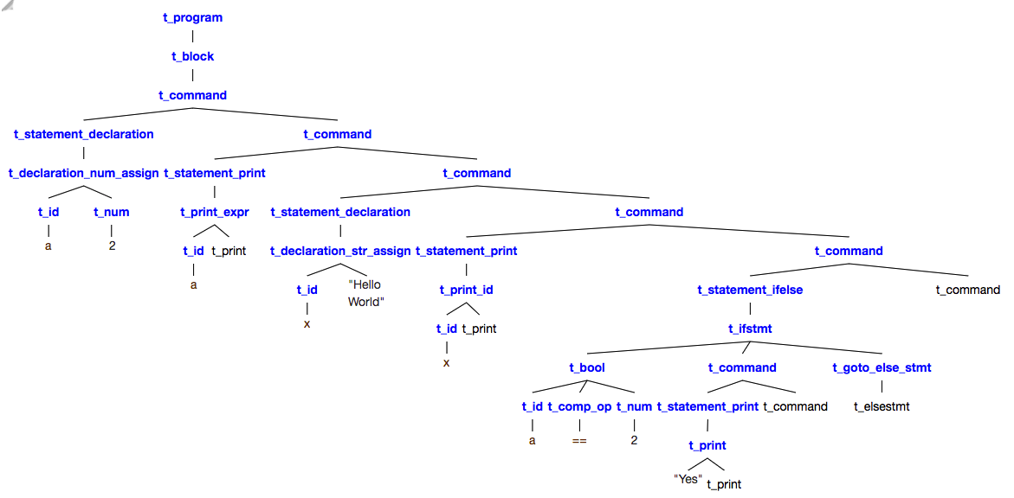
Parser
It takes all the tokens one by one and constructs the parse tree.
Symbol Table Data Structure and its Uses in Parser.
Symbol Table
Parser Output
Identifier | Type
x | num
y | stack
add | method

Slide 10
Semantics
Giving meaning to the parse tree
Symbol table Data Structure
- [(Identifier, Value, Type)]
O/P – Execution of I/P file
Identifier | Value | Type
x | 5 | num
A | [10,20] | stack
add | ((t_formal_parameter(t_id(x), t_formal_parameter(t_id(y), t_formal_parameter())),t_body(t_command(t_statement_print(t_print_expr(t_add(t_id(x), t_id(y)), t_print())), t_command())))) | method

Slide 11
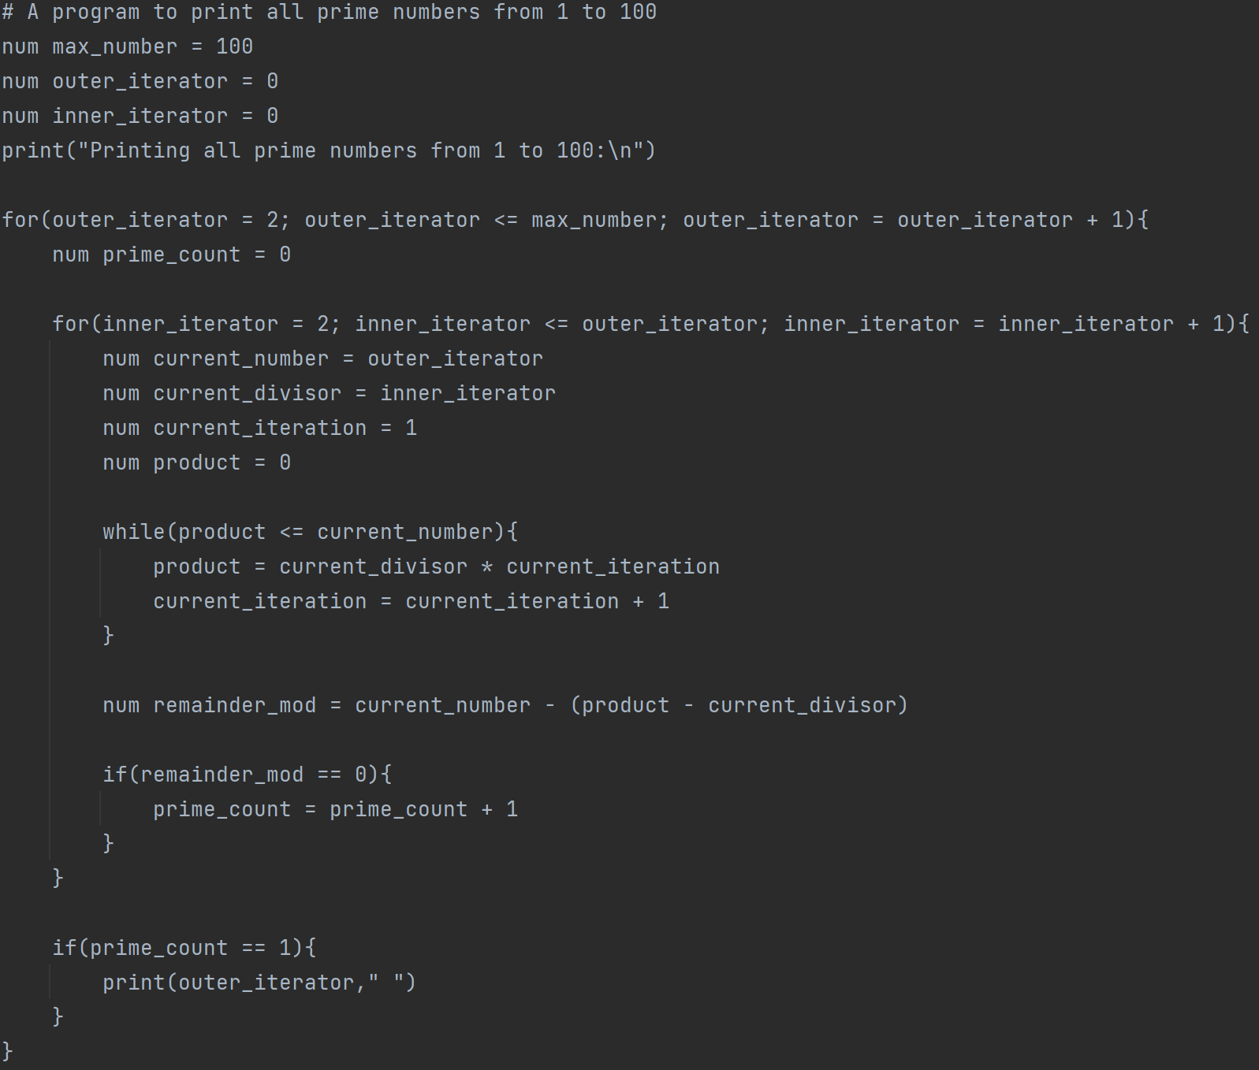
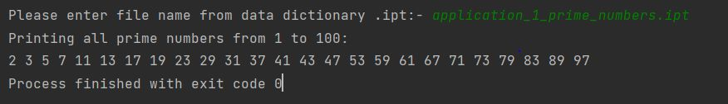
MyProgram.py
Open the terminal and enter below command
python MyProgram.py
Please enter file name from data dictionary .ipt:- application_1_prime_numbers.
Snapshot of the demonstration of the language

Slide 12
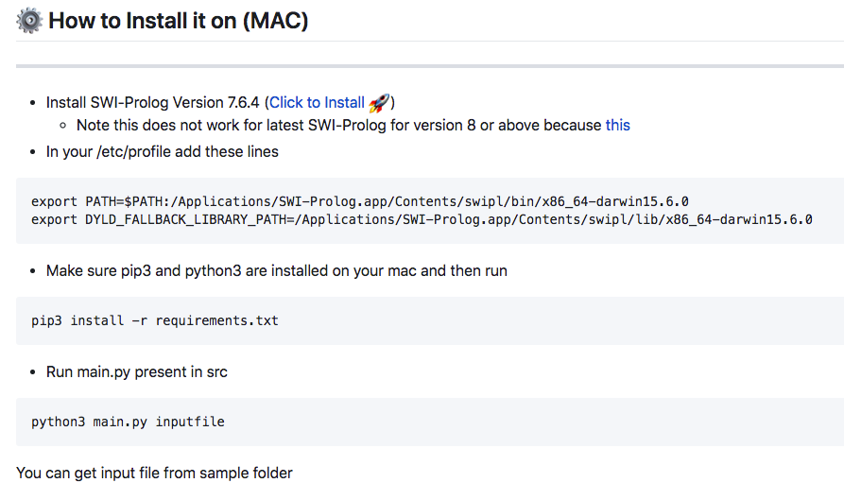
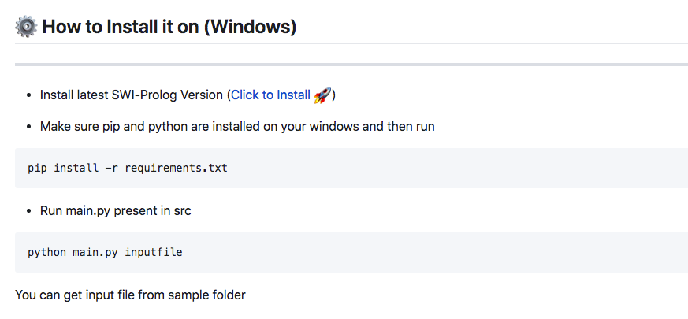
Installation Demonstration

Slide 13
Future Scope
Advanced Data Structure
User Defined Data types
Import Multiple files and functions
Recursion
Multi-threading

Slide 14
Sample Code Demonstration

